Slide 1
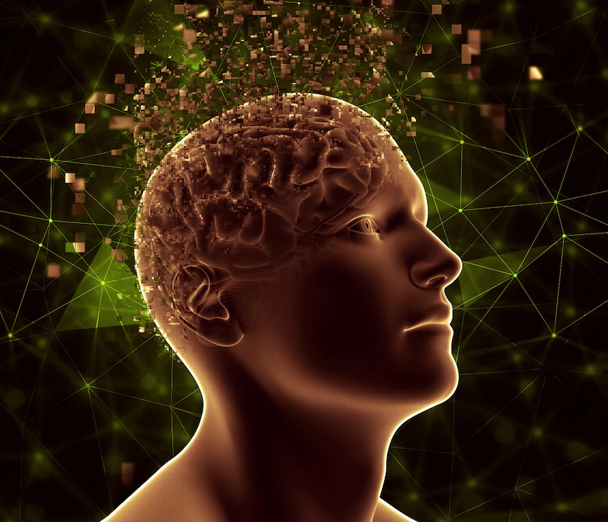
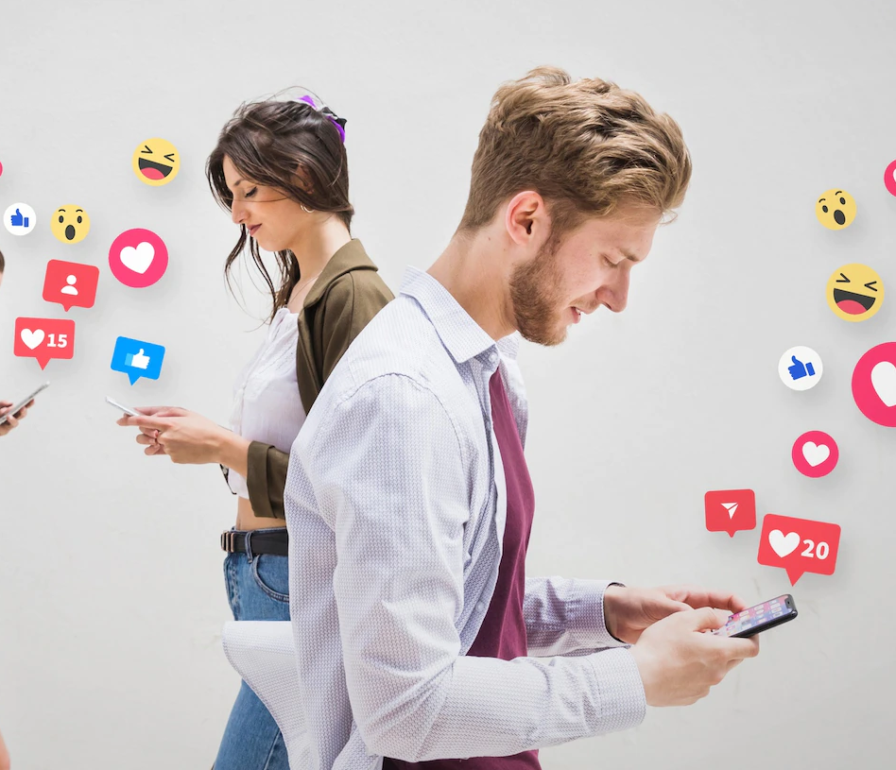
SAFETY IN
SOCIAL MEDIA
-Sooraj Sekar , Shubham Mishra , Indrayan Banerjee

Slide 2
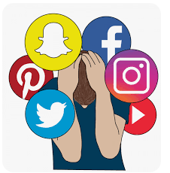
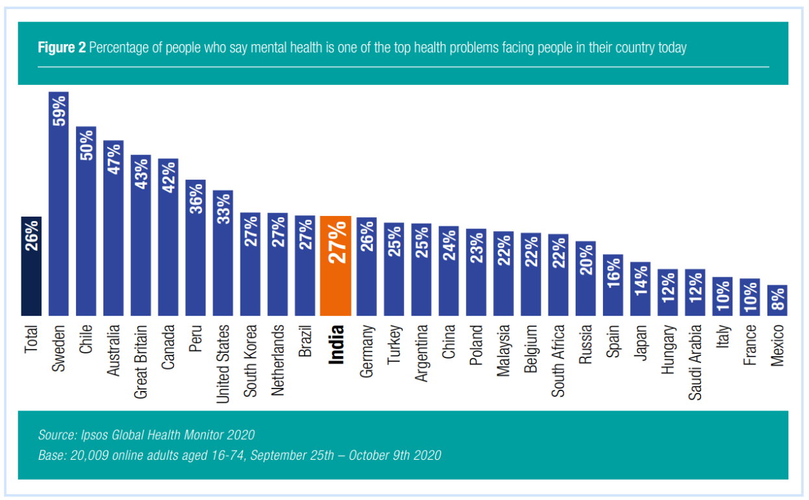



INTRODUCTION
What does Safety mean in Social Media
How social media has changed the landscape in India
Research Question
What is driving an increase in mental health issues attributed to social media for Indians?
Notes:
https://arxiv.org/ftp/arxiv/papers/2102/2102.09369.pdf
https://indianexpress.com/article/lifestyle/health/mental-health-in-india-impact-of-social-media-on-young-indians-facebook-instagram-youtube-twitter-7778499/

Slide 3
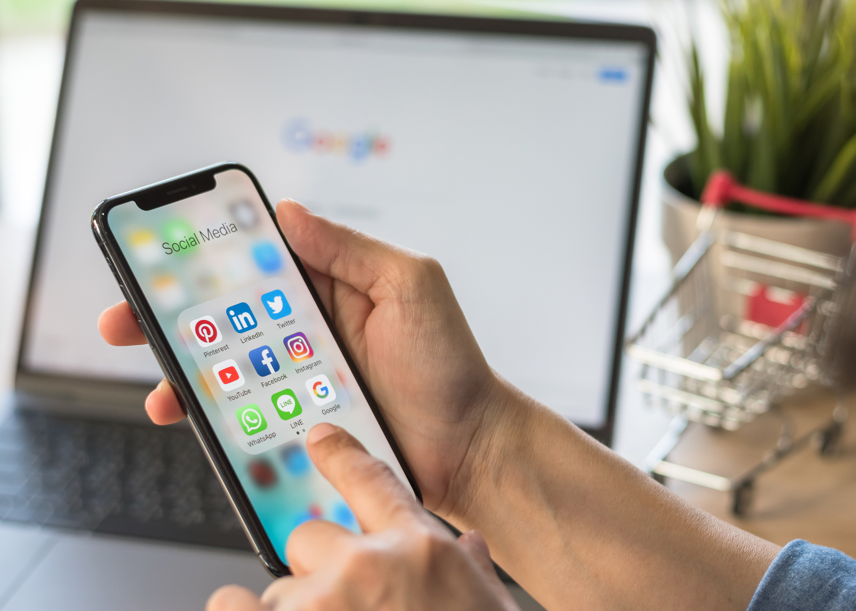
LITERATURE
REVIEW
Various Avenues to compromise Safety in social media
General Safety challenges
Danger of behavioral surplus - Leading to behavioural changes
Attack of the trolls - Unable to handle the pressure exerted
Danger of Influence of social media - Unable to differentiate Social and Real World
Introduction to Mental Health impacts
Link between Safety in social media and mental health
Various Factors contributing to mental health or the deterioration of it

Slide 4

METHOD
Research Proposed Methods
Leverage online survey results/ past study that studied the Effect of Social Media on Mental Health(stress) internationally.
Find the Purpose why people use Social Media
Learn about the normal habits like Sleeping hours, etc
Learn about reversal cases where users got impacted and have overcome
Compare with studies internationally
Notes:
Now let’s talk about the method which will be used to carry out this research proposal.
The first proposed method we will be using is by implementing online survey results and how social media is affecting mental health internationally.
We will also be what factors come into play in affecting social media
And lastly, we will analyze our results to the results internationally,
Within the scope, doing primary research is out of scope and we would rely on previous research artifacts to identify new insights. We would also look for any mental issues that arose out of involvement in protests in India.
We will conclude our findings and the answer to the question on the rise of mental health

Slide 5
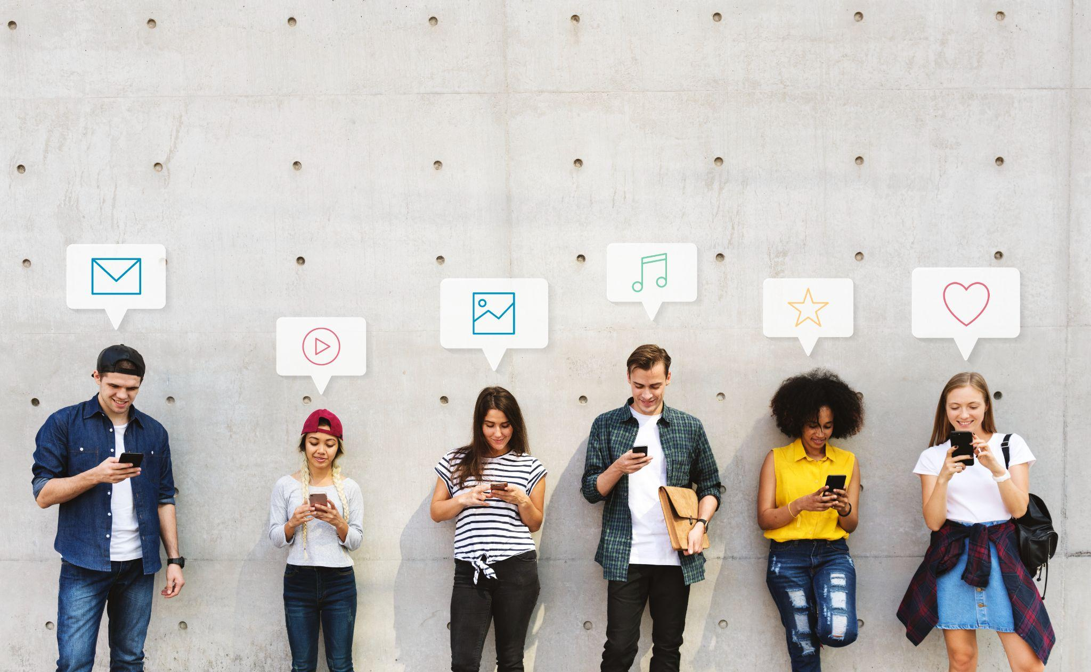
Improve the Mental health through proposed methods for social media platform
Foreseeable challenges
Change Proposal
Notes:
How mental health can be affected through our proposed methods and we will also briefly describe the challenges we have faced in the final paper.

Slide 6



CONCLUSION
Summary of the Analysis and Results
Conclusion on the impact along with the remedial actions that can be taken holistically
Notes:
For our conclusion, we will compare how social media interaction has changed during covid and along with the change in impact to mental health.
Also, we will talk about proposed solutions for this problem.

Slide 7

THANK YOU

